Slide 1
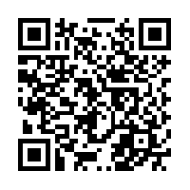
April is
Alcohol
Awareness
Month
TIPs
Training Intervention Procedures
April 3rd 5:00 Pm – 7:30 PM
April15th 2:00 PM – 4:30 PM
Register for a TIPS workshop to help your fellow Monarchs make wise choices concerning alcohol. Every participant that completes the training will be TIPs certified.
Every student that completes TIPs training will be entered in a drawing for a grand prize.
To Register :
or
FMI: cwinter@odu.edu
https://odu.co1.qualtrics.com/SE/?SID=SV_9HmushseCukKEVT
Monarch Wellness
ENVIROMENTAL
PHYSICAL
SOCIAL

