Slide 1
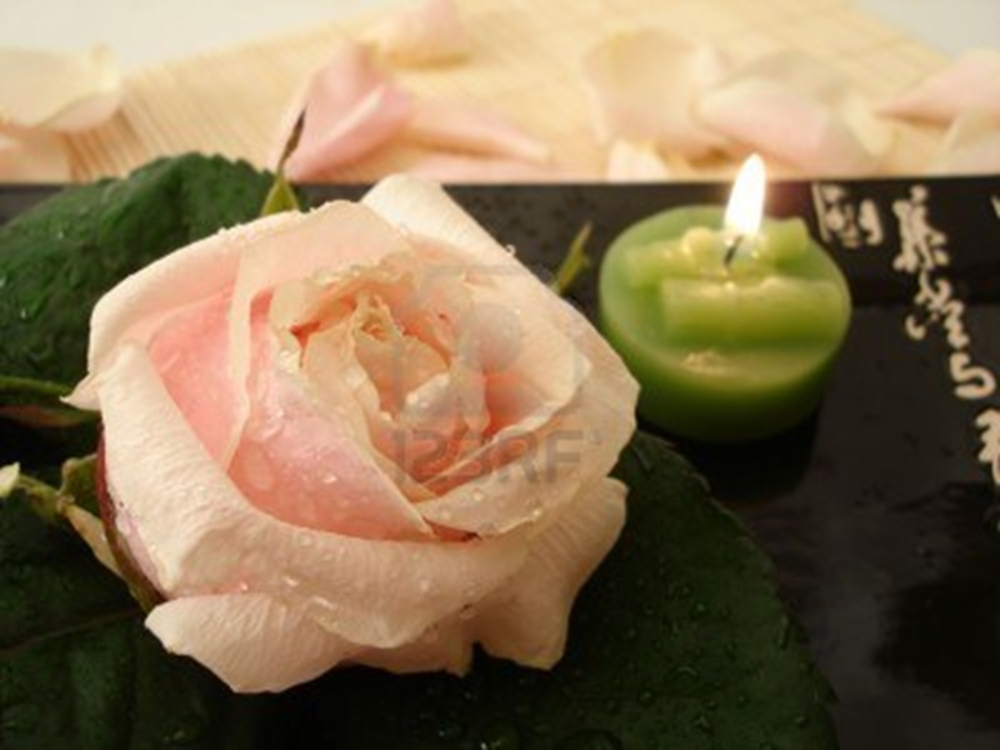
Illumination Project
“Remembering Kelly”
Kaufman Mall will be illuminated to remember “Kelly” and the 245 people who lost their lives in Virginia in 2011 due to an accident involving a drunk driver. Come out and experience this powerful visual and sign the pledge to never drink and drive.
Wednesday October 17th – 7:00pm

