Slide 1
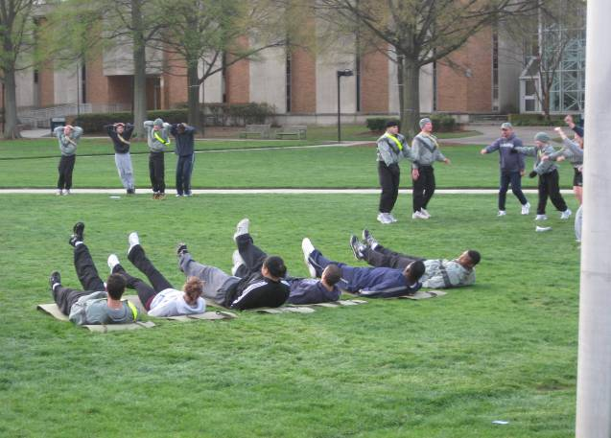
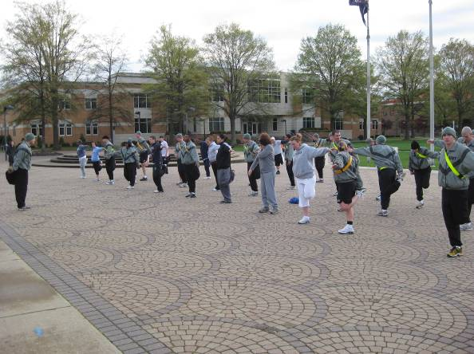
FACULTY, STAFF and STUDENT
Army ROTC Physical Fitness Day
It’s that time again to come out and join the
Army ROTC Monarchs for Physical Fitness!
We will be forming up in front of the Webb Center on April 8th at 7 a.m. to conduct Army Preparation Drill “Warm-Ups” and execute four stations of inspiration and perspiration!
Wear comfortable work out attire and bring water. HOOAH!!!!!!!
Questions? Call 683-6603 and ask for Master Sergeant DeSanto!
Join us April 8th at 7 a.m. in front of Webb Center!!

