Slide 1
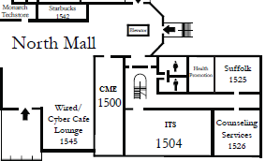
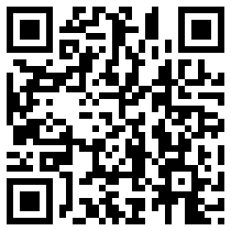
The Office of Counseling Services Invites You to
JOIN US FOR AN
OPEN HOUSE
Come and take this opportunity to learn more about what
Counseling Services has to offer!
Meet the counselors!
Tour the office!
Participate in games and activities!
Food and refreshments will be provided!
September 4th 2014
11am – 2pm
1526 Webb Center
For more information call 757-683-4401

