Slide 1
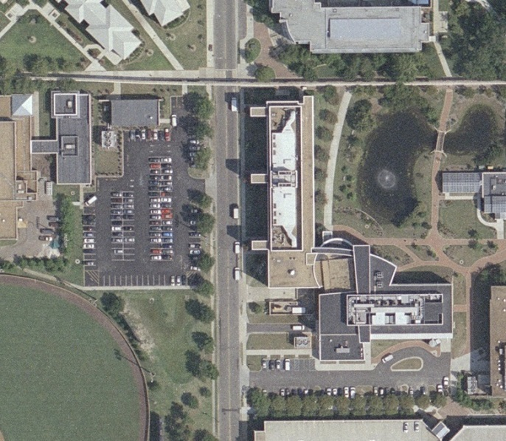
Oceanography HVAC Replacement Project Site Plan
Contractor’s Laydown Area
Equipment to be Replaced
New Chilled Water Line

