Slide 1
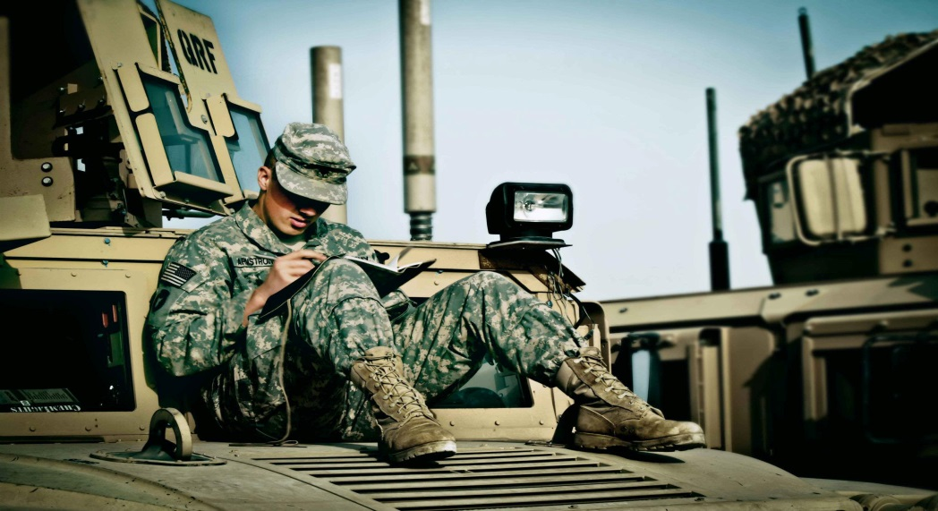
Veterans Writing Project
March
29th-30th
If you are a military affiliated or a veteran of the United States Armed Forces, then you are invited to attend, free of charge, a two day writing workshop at Old Dominion University Virginia Beach Center
Interested in participating in the Veterans Writing Project should RSVP, Jose Roman ASAP at Jrroman@ODU.edu
Sponsored by
ODU Military Connection Center

