Slide 1
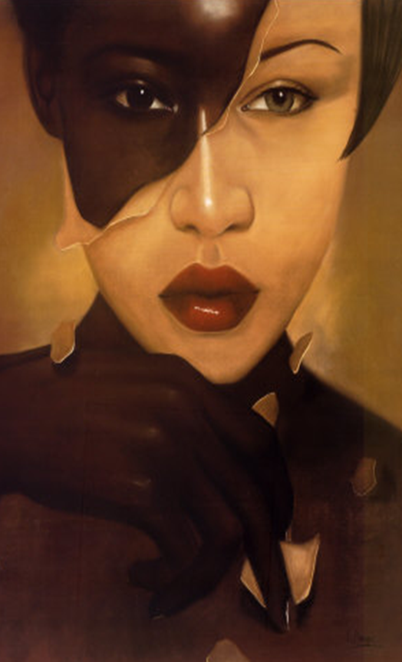
Black Like Who?
Movie Screening and Discussion
In this painfully honest documentary, filmmaker Debbie Reynolds explores themes of assimilation, internalized racism and self-hatred. Debbie is a Black student who grew up in a white neighborhood, went to white schools, had white friends, and did not think about being Black. As she grew older and left home, her new friends at college noticed her inability to relate easily to other blacks. Debbie realized she had a troubling identity problem and she searched for its origins within her family. This is a unique film to spark discussion on racial identity.
Tuesday, February 4, 2014
5pm
Webb Center
Hampton/NN Room
Co Sponsors:
Office of Counseling Services
F.I.R.S.T.
(Females Inspired by Reaching Success Together)

