Slide 1
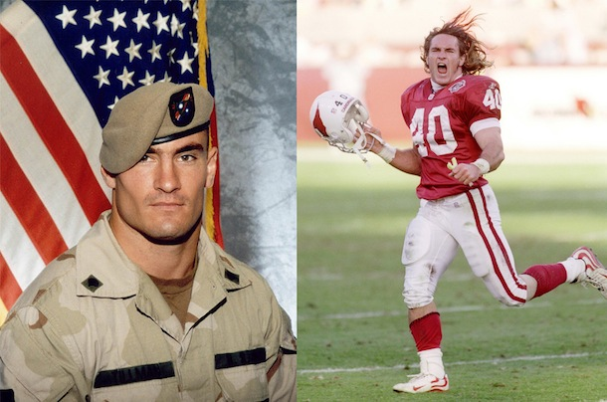
Become a Tillman Military Scholar
Info Session for the Student Veterans Association
Wednesday, 26 FEB 2014 @ 1230
Portsmouth room, Webb Center – food provided

