Slide 1
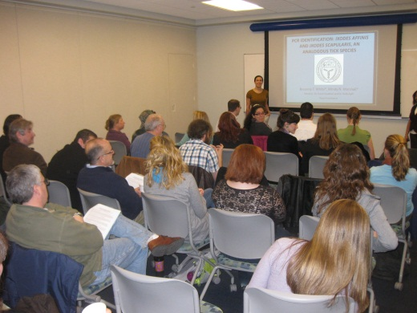
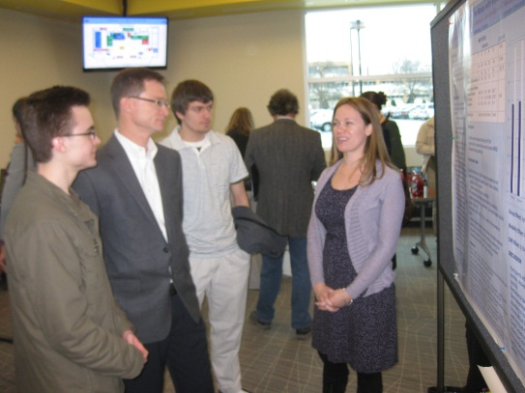
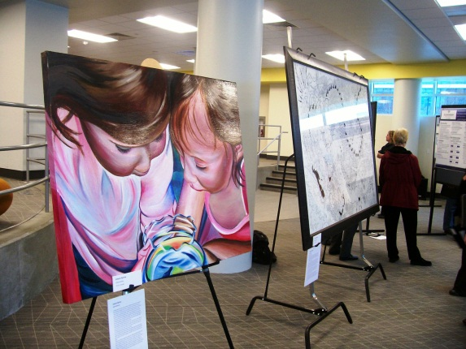
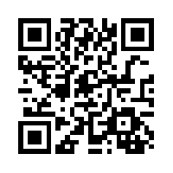
Undergraduate Research Symposium February 7th -8th, 2014; Learning Commons Perry Library
Undergraduate research presentations from
Art, History, Biology, Counseling, Physics and more!
Presentations from undergraduate Research Grant Award Winners
Posters featuring undergraduate research from
Psychology, Engineering, Political Science, Media Studies and Earth Sciences
Art Exhibition featuring undergraduate creative works in
Painting, Drawing, Graphic Design, and Sculpture.
FREE and open to all students, faculty, staff, and
members of the ODU community!!!!!
Sponsored by:
See the schedule at: http://www.odu.edu/research/student/undergradresearch/symposiumFree registration at:
http://ww2.odu.edu/forms_admin/viewform.php?formid=16478
Honors College
Undergraduate Research Program

