Slide 1
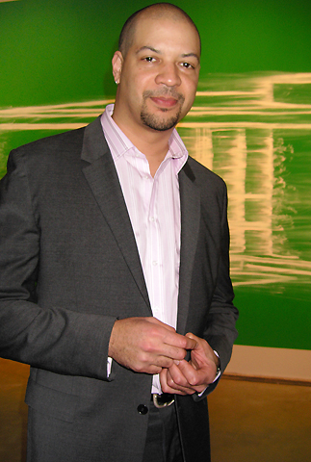
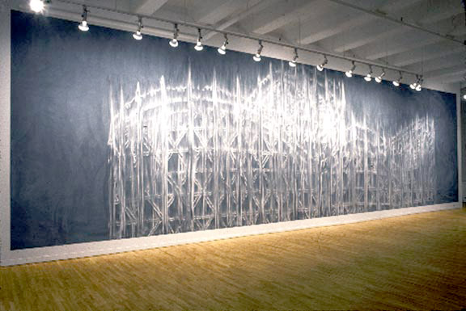
ODU Visiting Artist Lecture:
Gary Simmons
Friday, October 26 at 4 p.m.,
Artist Reception 3:30 p.m.
Room 1012 Batten Arts and Letters Building, 4227 Hampton Blvd., Norfolk
Gary Simmons is known for his ghostly erasure drawings and provocative installations confronting stereotypes related to race, identity, and culture. This public lecture, a response to the Chrysler’s recent exhibition 30 Americans, is cosponsored by ODU’s Art Department, College of Arts and Letters, and the Chrysler Museum of Art.
For more info.
683-4047

